Slide 1

Assisting Healthcare Providers in Error Avoidance
Nicholas, Nishant, David, Tiffany
14 December 2017

Slide 2
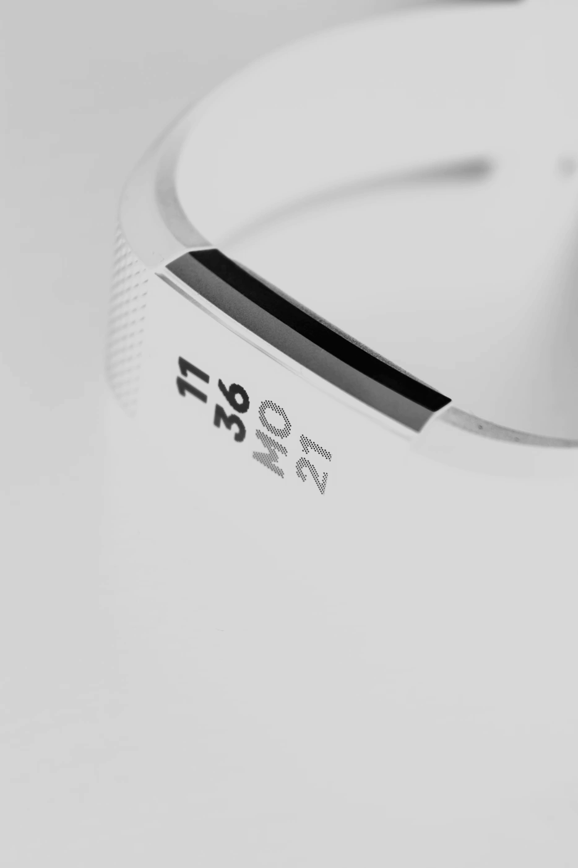
Data Science in the Domain
Wearables in the workspace used for:
Productivity
Security
Wellness
Several companies aim to measure fatigue
SmartCap
Fitbit
Google Glass
Notes:
Nicholas
Currently, wearable devices are used in numerous applications. The enterprise edition of Google Glasses has been utilized to assess processes and bolster productivity through gains in efficiency.
Additionally, most of us are well acquainted with the use of employee security badges, in fact for many of us we can’t even get into work without one.
Furthermore, many companies have initiated programs to increase employee activity through the use of pedometers. So, its safe to say that wearable devices are a common occurrence in todays business environment
Now to take that a step further there are several companies that aim to measure fatigue specifically. Smart cap is a device that uses EEG to directly measure fatigue this is already seeing use in the mining and transportation industries.
Fitbits are a wrist worn device that are able to measure parameters such as heart rate, step count as well as sleep.
Finally, in the near future we may see google glasses with the ability to track eye movement, which can be used to track attention and fatigue.

Slide 3


Research Question
Can we associate rates of medical malpractice with employee fatigue signals as measured by wearable devices?
Notes:
Nicholas
So the question we set out to answer is as follows, Can we associate rates of medical malpractice with employee fatigue signals as measured by wearable devices.
The reason this is an important question is because malpractice costs measure in the billions annually. Decreasing fatigue related errors will have a direct impact on the bottom line of medical insurance providers. However, Beyond just the dollar cost is the impact errors have on the life of the patients. By understanding and reducing fatigue related errors we aim to assist medical professionals in their end goal of bettering the life of their patients.

Slide 4


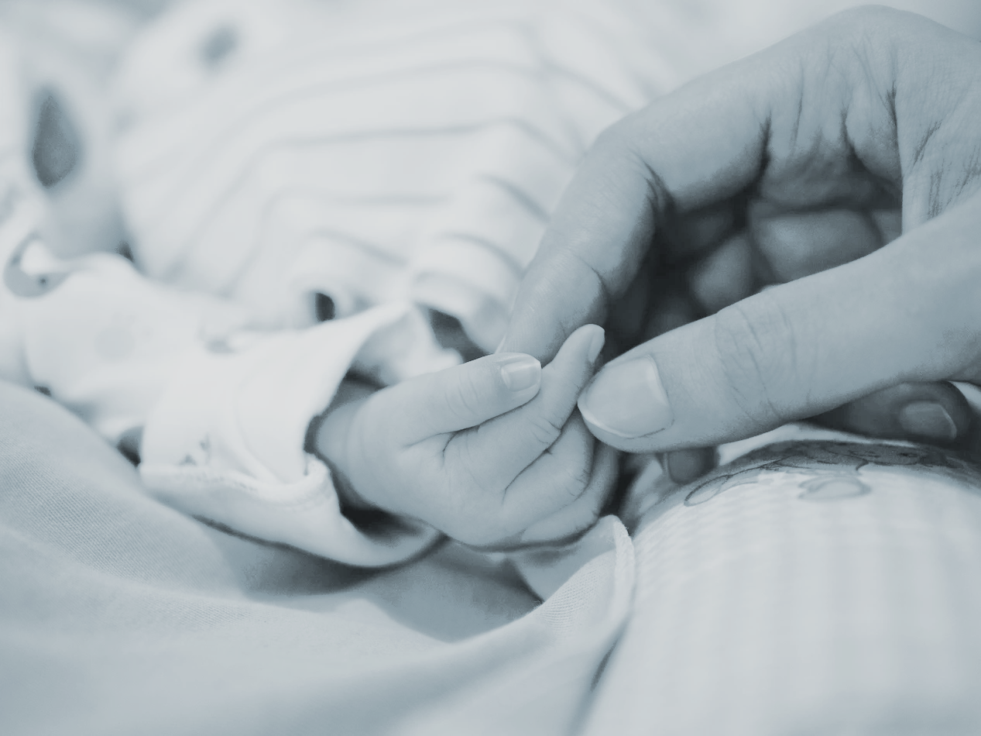

Data and Methods
STEP 1
STEP 2
STEP 3
Observation Period
Analysis Period
Operational Period
Capture individual baselines Capture error rate throughout period
Correlate different signals with errors Calculate acceptable thresholds for each signal
Identify insurance companies and care providers as potential customers Evangelize and market
Notes:
Nishant
We propose a 3 stage approach to solving this problem. Our needs are to gather data, understand the data, and onboard stakeholders. In our first stage, we will focus on data collection. We will use a teaching hospital for this period: we plan to market our idea to insurance companies and leverage their support to offer a discount on malpractice insurance premiums to a willing hospital. We will set baselines with a subsample of nurses and residents. We will introduce them to the EEG/smartcap technology in person and take a quick baseline of their signals in person to prevent spoofing. We will then passively collect data from these individuals: this collection period will last between 6 months and one year. During this time, we will also tabulate avoidable errors made.
In Stage two, we will analyze the data we have collected and identify EEG patterns in which more mistakes are made, calculating acceptable thresholds. This will require the explicit identification of avoidable errors, in addition to the creation of a structuring of EEG data and individual baselines.
Finally, we will evangelize this technology at conferences once we have quantified our reduction in error rates and associated cost.

Slide 5
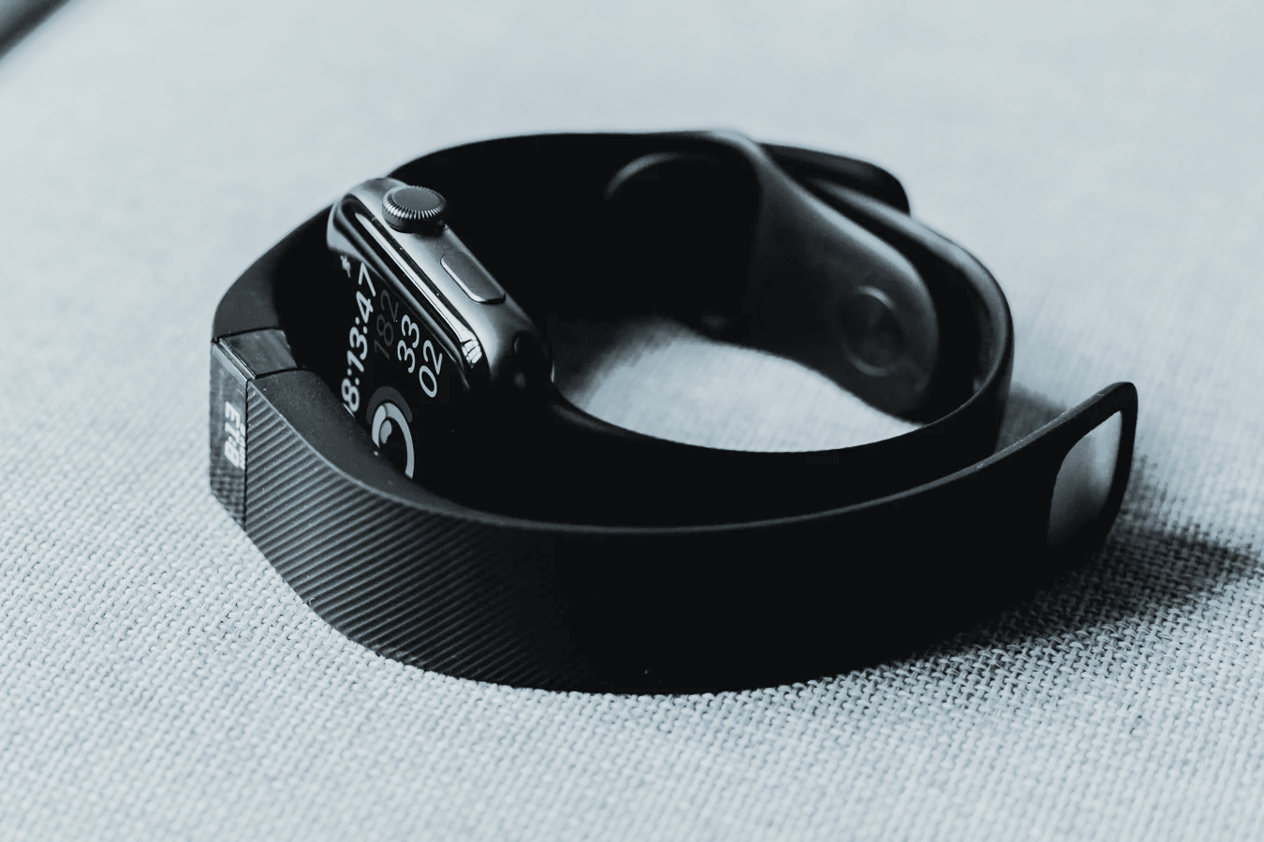



Final Product
Stakeholders
Personal stress and fatigue monitoring platform/dashboard
Health insurance companies
Healthcare professionals
Wearable hardware companies
Healthcare legislators
Stakeholder
Identification & Onboarding
Onboarding: Insurance
Onboarding: Community
Pitch cost reduction potential
Offer malpractice insurance premium discounts
Present findings at conference to earn recognition
Notes:
David Lindsey
The final Product would include
Physical sensors for collecting metrics
Indicators for heart rate, sleep patterns, and hydration.
Alerts for stress or fatigue level proximity as well as suggestions/reminders for sleep, water intake, food intake
The primary stakeholders and target audience would be
Health insurance companies & providers
As Cost cutting instrument for insurance and tool for safety/transparency among covered providers
The other most important stakeholders would be
Healthcare professionals, doctors, nurses and staff who are the individuals being “monitored’ but the wearables.
Of course then
Wearable monitor hardware producers like -- fitbit, apple, samsung as the Accuracy of data and the power of model will be instrumental
Also healthcare and policy legislators -
as the use of wearable health data does not have legal precedents in any landmark malpractice or other cases for that matter, the extent to which it can be used may pose important legal questions
There also need to be standards for the validity of metrics gathered. The FDA has already set up a recertification program for digital health products
On-boarding would start with health insurance companies who might offer malpractice insurance premium discounts for a university hospital or other health care provider willing to test the product
It would be pitched to the provider as both an HR and client services enhancement tool. Well-rested doctors, nurses, and staff lead to better service
Findings would be presented at conferences to earn recognition and improve the product through a feedback loop.

Slide 6
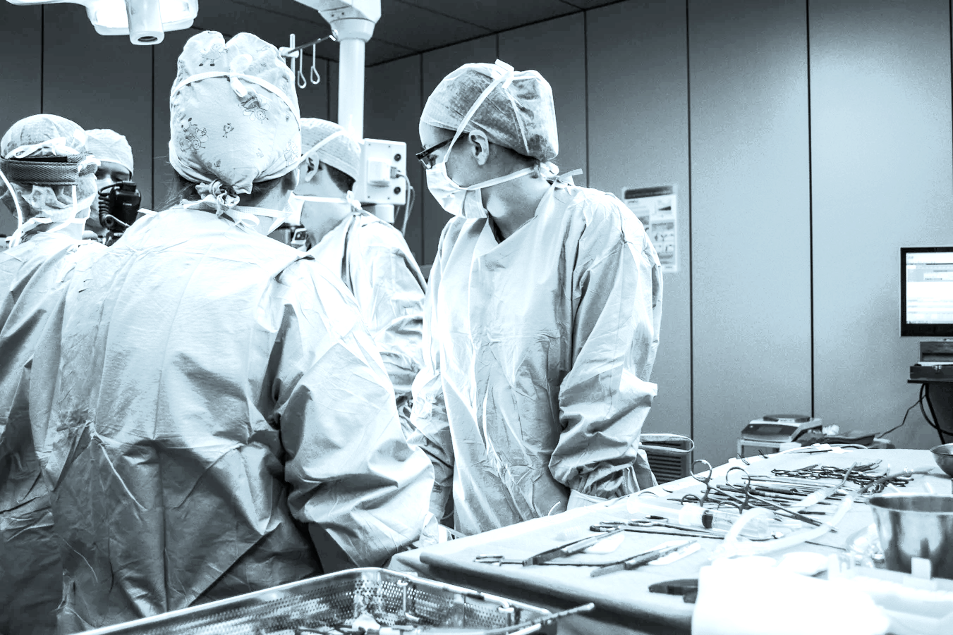
Risks & Contingencies
Enforcing findings
Broken system
Require standard of accuracy
Handling gamification
Cannot avoid hindsight bias
Intrusion of privacy
Jeopardize reputation through transparency
Notes:
Tiffany Jaya
We rely on healthcare professionals to use these data in a meaningful way. But if the system is already broken (for example, if hospitals cannot afford to send doctors home from fatigue), no amount of information we provide can fix the problem.
In addition, decisions are being made from our algorithms. We have to ensure that these algorithms meet a certain threshold of accuracy, including potential gamifications employees might exercise, for example, to take days off from a feigned fatigue. As accurately as our algorithms might be, decision makers might still fall prey to the hindsight bias. Things that were not seen at the time of the accident seem obvious in retrospect, and it can become easy to blame the doctor who is fatigue when in fact the accident is caused by a combination of factors.
For this reason, it is understandable why the healthcare industry might have the greatest resistance to the adoption of the product. Doctors might not want to have their health monitored outside of work because of privacy concerns. Hospitals might not want to have their errors quantified transparently out of concern for their reputation. But we must remember the end justifies the mean, and identifying the problem is the first step to correcting it.

Slide 7
Future Work/Unanswered Questions
1
Invisible or Implanted
Wearables
2
Optimize the System
3
Branch Out to
Other Fields
4
Publish Results
on Effects of Stress
Notes:
Tiffany Jaya
Identifying fatigue is one way to optimize the most important asset in the healthcare industry: our doctors and nurses. We can increase the adoption rate by improving the wearable devices to become invisible to the user, but if we wanted to make the greatest impact, we can branch out to optimize other assets currently in place. For example, we can develop a centralized command-and-control capability similar to an air traffic control system in airports that delivers prescriptive recommendations throughout the system. It will further quantify risks and reduce the chances of recurrence in avoidable error.
The success of our product allows us to branch to other fields where ongoing resistance to sleep is safety critical. Like firefighters or air traffic controllers (If you watch Breaking Bad, you know what I’m talking about). And we can publish the results on the effects of job-related stress so that the public have better insight what stress does to the body.

Slide 8
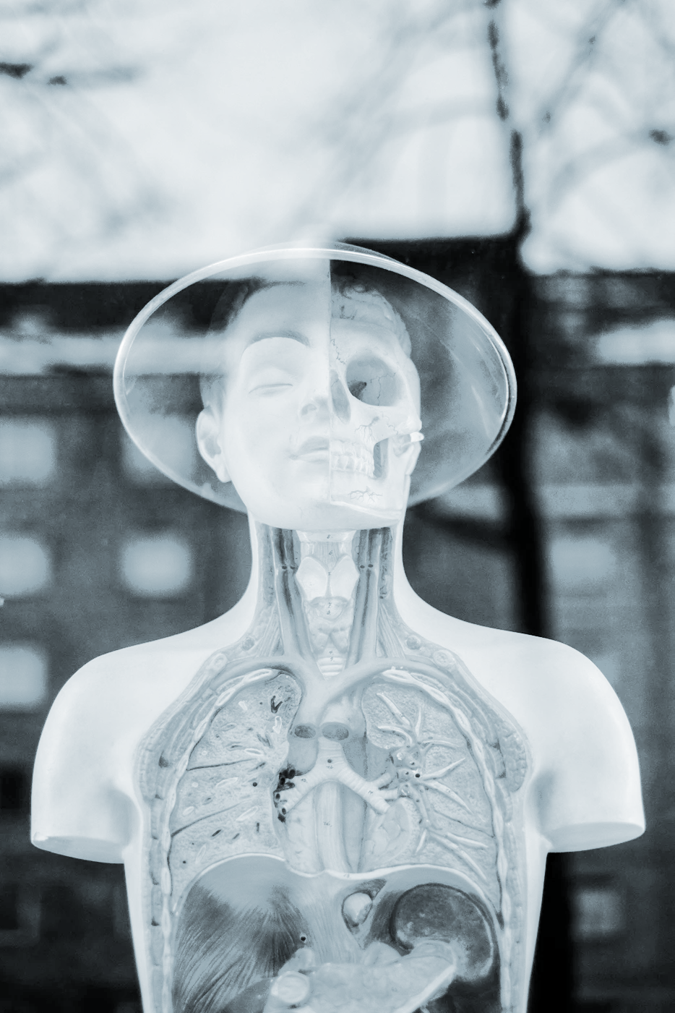

Q U E S T I O N S
Nicholas - nconidas@berkeley.edu
Nishant - nishray@berkeley.edu
David - david.lindsey@berkeley.edu
Tiffany - tiffanyjaya@berkeley.edu
Notes:
Tiffany Jaya
I hope you have come to agree that identifying fatigue is the first step to optimize the healthcare industry. If you have further question, please feel free to reach us out in the following emails. Thank you.

Slide 9
Bibliography
“Fatigue – A Silent Killer!” Wearable Technologies, 29 July 2016, www.wearable-technologies.com/2016/07/fatigue-a-silent-killer/.
Nield, David. “A new wearable sensor can detect dehydration and fatigue.” TechRadar, TechRadar The source for Tech Buying Advice, 29 Jan. 2016, www.techradar.com/news/wearables/a-new-wearable-sensor-can-detect-dehydration-and-fatigue-1314024.
“Home.” Developing wearable technology for monitoring fatigue, www.tech4symptoms.org/.
https://med.stanford.edu/content/dam/sm/sm-news/documents/StanfordMedicineHealthTrendsWhitePaper2017.pdf
Agrawal, Sanjeev. “Why Hospitals Need Better Data Science.” Harvard Business Review, 20 Oct. 2017, hbr.org/2017/10/why-hospitals-need-better-data-science.
“Can SmartCap EEG be used for other purposes?” SmartCap Help Centre, support.smartcaptech.com/hc/en-us/articles/204160160-Can-SmartCap-EEG-be-used-for-other-purposes-.
“Our Blog.” Encompass Risk, www.encompassrisksolutions.com/2017/11/01/smartcap-senses-brainwaves-in-truck-drivers-to-monitor-fatigue/.
“Read "To Err Is Human: Building a Safer Health System" at NAP.Edu.” National Academies Press: OpenBook, www.nap.edu/read/9728/chapter/5.
https://www.ncbi.nlm.nih.gov/pmc/articles/PMC2639900/

Slide 10
Appendix

Slide 11
Data and Methods
Observation Period: use SmartCap devices to capture EEG data and smart watch devices to capture heart rate
Capture individual baselines
Capture error rate throughout period
2. Analysis period:
Correlate different signals with errors
Calculate acceptable thresholds for each signal
3. Operational period:
Identify insurance companies and care providers as potential customers
Evangelize and market

Slide 12
Risks and Contingencies
How do we enforce the conclusions taken from these algorithms?
System failures only made more clear through these data
It is cheaper to pay overtime than hire more people
Hospitals may not be able to afford to send people home for fatigue
Personnel decision made off these algorithms rely on some degree of accuracy
Decisions are being made from measurements of these equipments; therefore, these equipments have to meet a certain threshold of accuracy.
Gamification
Hindsight bias (things that were not seen or understood at the time of the accident seem obvious in retrospect) can oversimplify the problem
Intruding on employees privacy
Quantified error: transparency could concern stakeholders
Notes:
Tiffany Jaya
We rely on healthcare professionals to use these data in a meaningful way. But if the system is already broken (for example, if hospitals cannot afford to send doctors home from fatigue), no amount of information we provide can fix the problem.
In addition, decisions are being made from our algorithms. We have to ensure that these algorithms meet a certain threshold of accuracy, including potential gamifications employees might exercise, for example, to take days off from a feigned fatigue. As accurately as our algorithms might be, decision makers might still fall prey to the hindsight bias. Things that were not seen at the time of the accident seem obvious in retrospect, and it can become easy to blame the doctor who is fatigue when in fact the accident is caused by a combination of factors.
For this reason, it is understandable why the healthcare industry might have the greatest resistance to the adoption of the product. Doctors might not want to have their health monitored outside of work because of privacy concerns. Hospitals might not want to have their errors quantified transparently out of concern for their reputation. But we must remember the end justifies the mean, and identifying the problem is the first step to correcting it.

Slide 13
Stakeholder Identification and Onboarding
Final Product
Personal stress and fatigue monitoring platform/dashboard
Stakeholders
Health insurance companies & providers
Healthcare professionals
Wearable hardware companies -- fitbit, apple, samsung
Data service providers
Healthcare legislators
Onboarding
Start with insurance companies, pitch cost reduction potential
Offer malpractice insurance premium discounts for a university hospital willing to test the product (observation and analysis)
Present findings at conferences to earn recognition (operational period)
Notes:
David Lindsey
Final Product
Physical sensors
Indicators: heart rate, sleep patterns, hydration...
Alerts to individual users for stress or fatigue proximity
Personal health alerts and trend notifications
Suggestions/reminders for sleep, water intake, food intake
ealth insurance companies & providers
Cost cutting instrument for insurance, safety/transparency instrument for providers
Healthcare professionals
Individuals being “monitored’, availability of data up for debate (potential ethical concern)
Wearable hardware companies -- fitbit, apple, samsung
Accuracy of data/power of model incredibly important
Data service providers --
there will need to be data networks capable of accommodating the amount of measurable data for individuals being monitored. The data may or may not constitute health related data and thus may have certain legal protections or require particular levels of security
Healthcare legislators -
as the use of wearable health data does not have legal precedents in any landmark malpractice or other cases for that matter, the extent to which it can be used may pose important legal questions
Start with insurance companies, pitch cost reduction potential
Offer malpractice insurance premium discounts for a university hospital willing to test the product (observation and analysis)
Improvement of employee relations
Improvement of services
Present findings at conferences to earn recognition (operational period)

